Slide 1
Topical Review 1
Tables, Histograms, Functions, Iteration, Sampling

Slide 2
Tables

Slide 3
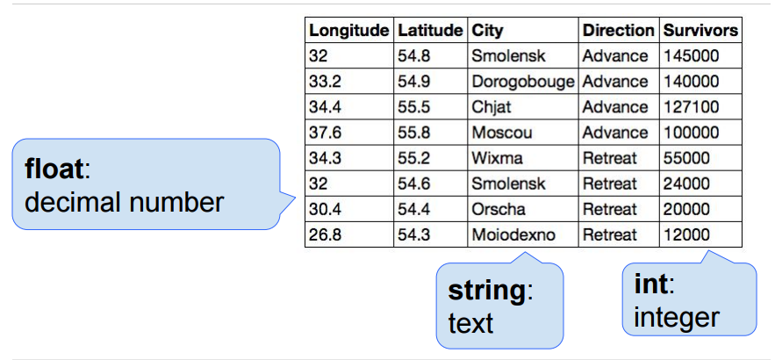
Tables Structure
Table is a sequence of labeled columns
Labels are strings
Columns are arrays!

Slide 4
Tables
Good table methods to know how to use
where drop apply
column sort
select take
group relabeled
join pivot
with_columns sample

Slide 5
Tables
How do we find the number of rows in a table?
tbl.num_rows
How do we find the number of columns in a table?
tbl.num_columns
How do we get an item out of the table?
tbl.column(‘Column Name’).item(Number)
Notes:
Last bullet point: we can sort the table and get the first item

Slide 6
Where
tbl.where(column, predicate)
A table of the rows for which the column satisfies some predicate.
“Filtering” out rows by a condition
Returns a table
List of “where” predicates: https://www.inferentialthinking.com/chapters/06/2/Selecting_Rows

Slide 7
Group
table.group(column, function)
Group table by categories
1st argument: column we want to group by (string or int)
Split column into unique values
2nd argument: (optional) function to aggregate arrays

Slide 8
Group's 2nd Argument
No argument: creates “count” column
Number of rows for each category
Argument: creates “ColName FunctionName” column
Applies function to values in “ColName” for each category
sum, mean, min, max, len, abs, or define your own functions and pass them in!
Functions must operate on arrays

Slide 9
Example
sp16.drop(‘Class’).group(‘StudentID’, np.mean)
Student ID | Class | GPA
1234 | CS 61A | 3.3
5678 | CS 61A | 3.0
5678 | DATA 8 | 4.0
Student ID | GPA mean
1234 | 3.3
5678 | 3.5

Slide 10
Group by multiple columns
table.group([“column_1”, “column_2”], function)
Group table by combination of categories from >1 column
First Argument: array of column names
Second Argument: same as grouping using one column
Seems similar to a function we’ve seen earlier…

Slide 11
Join
tbl_1.join(“tbl_1_column”, tbl_2, “tbl_2_column”)
Combine 2 tables
Arguments: (Join takes 3 arguments)
1st argument: column to join on from the first table
2nd argument: second table to join with
3rd argument (optional): column to join on from the second table

Slide 12
Join Example
prof
sp16
Course | Professor
CS 61A | Hilfinger
DATA 8 | DeNero
Student ID | Class | GPA
1234 | CS 61A | 3.3
5678 | CS 61A | 3.0
5678 | DATA 8 | 4.0
sp16.join(‘Class’, prof, ‘Course’)

Slide 13
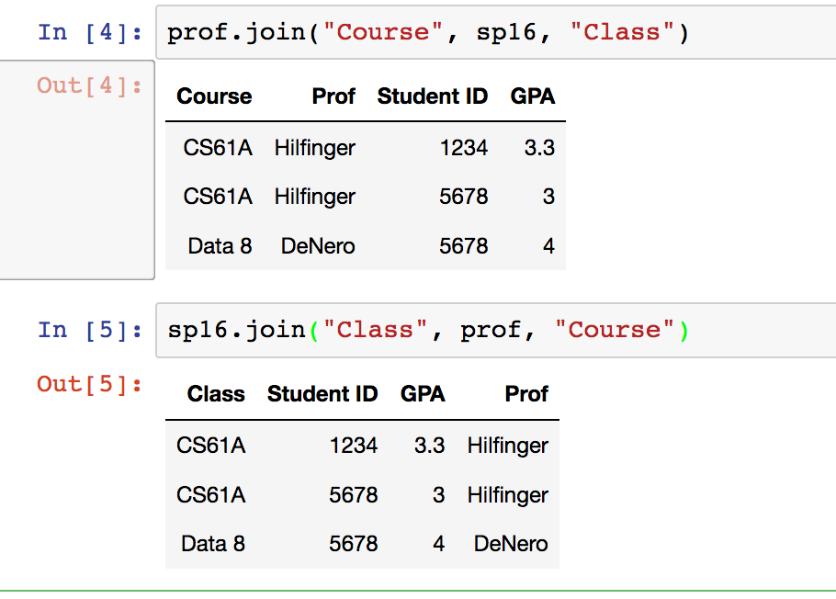
Order Matters!

Slide 14
Pivot
Aggregate by combinations of the unique values in two columns
Arguments: (Pivot takes either 2 or 4 arguments)
1st argument: category unique on the columns
2nd argument: category unique on the rows
Note: if we stop here with 2 arguments, the default values are counts
3rd argument: values to aggregate
4th argument: aggregate function
tbl.pivot(“colsLabel”, “rowsLabel”)
tbl.pivot(“colsLabel”, “rowsLabel”, “valuesLabel”, collectFunction)

Slide 15
Pivot Example 1
sp16.pivot(‘Student ID’, ‘Class’)
Student ID | Class | GPA
1234 | CS 61A | 3.3
5678 | CS 61A | 1.0
5678 | CS 61A | 3.7
5678 | DATA 8 | 4.0
Class | 1234 | 5678
CS 61A | 1 | 2
DATA 8 | 0 | 1

Slide 16
Pivot Example 2
sp16.pivot(‘Student ID’, ‘Class’, ‘GPA’, np.mean)
Student ID | Class | GPA
1234 | CS 61A | 3.3
5678 | CS 61A | 1.0
5678 | CS 61A | 3.7
5678 | DATA 8 | 4.0
Class | 1234 | 5678
CS 61A | 3.3 | 2.35
DATA 8 | 0 | 4.0

Slide 17
Practice Problem 1
We have a table exports containing the export amounts (in millions of dollars) of various agricultural products from California in the year 2014. The first column is labeled “Product”, while the second is labeled “amount”.
Write a line of code that defines avg_amt as the average of the amount column
Write a line of code that returns a table with only the rows with values which are above the average amount

Slide 18
Practice Problem 1: Solutions
a. Write a line of code that defines avg_amt as the average of the amount column
avg_amt = np.mean(exports.column(‘amount’))
b. Write a line of code that returns a table with only the rows with values which are above the average amount
exports.where(‘amount’, are.above(avg_amt))

Slide 19
Practice Problem 1
We have a table exports containing the export amounts (in millions of dollars) of various agricultural products from California in the year 2014. The first column is labeled “Product”, while the second is labeled “amount”.
c. Write a line of code that returns True if any exports are less than 1 million dollars.
d. Write a line of code that returns the proportion of exports that are between 50 and 100 million dollars.

Slide 20
Practice Problem 1: Solutions
c. Write a line of code that returns True if any exports are less than 1 million dollars.
d. Write a line of code that returns the proportion of exports that are between 50 and 100 million dollars.
exports.sort(‘amount’).column(‘amount’).item(0) < 1
min(exports.column(‘amount’)) < 1
exports.where(‘amount’, are.between(50,100))
.num_rows / exports.num_rows

Slide 21
Practice Problem 2
Name | Rating | # of Seasons | Genre | Premiere Year
Grey’s Anatomy | 7.7 | 12 | medical drama | 2005
Suits | 8.7 | 5 | legal drama | 2011
House of Cards | 9 | 4 | political drama | 2013
Scrubs | 8.4 | 8 | sitcom | 2001
Scandal | 7.9 | 5 | political drama | 2012
How I Met Your Mother | 8.4 | 9 | sitcom | 2005
Alice wants to pick a new TV show to watch, and decides to use some data she found online about various TV shows to make a decision. The table of TV shows she is using is called tv_shows, and each row corresponds to a unique show. The first 6 rows of the table are shown above.

Slide 22
Practice Problem 2
Name | Rating | # of Seasons | Genre | Premiere Year
Grey’s Anatomy | 7.7 | 12 | medical drama | 2005
Suits | 8.7 | 5 | legal drama | 2011
House of Cards | 9 | 4 | political drama | 2013
Scrubs | 8.4 | 8 | sitcom | 2001
Scandal | 7.9 | 5 | political drama | 2012
How I Met Your Mother | 8.4 | 9 | sitcom | 2005
a) There are initially too many options to choose from, so Alice decides to filter the table to only include shows that satisfy both of the following conditions:
Has at least an 8.0 rating.
Has at least 6 seasons.
Write an expression that will filter tv_shows such that only the rows satisfying both of the above conditions will be included.

Slide 23
Practice Problem 2: Solutions
tv_shows.where(‘Rating’, are.above_or_equal_to(8)).where('# of Seasons', are.above_or_equal_to(6))

Slide 24
Practice Problem 2
b) Alice realizes that she doesn't even know what type of show she wants to watch, so she decides to look at what genres people seem to like best.
First, write an expression that will create a table with the average rating for each Genre and assign it to the variable shows_grouped_by_genre.
Then, use this table to find the Genre with the highest average rating and assign it to the variable highest_rated_genre.
Name | Rating | # of Seasons | Genre | Premiere Year
Grey’s Anatomy | 7.7 | 12 | medical drama | 2005
Suits | 8.7 | 5 | legal drama | 2011
House of Cards | 9 | 4 | political drama | 2013
Scrubs | 8.4 | 8 | sitcom | 2001
Scandal | 7.9 | 5 | political drama | 2012
How I Met Your Mother | 8.4 | 9 | sitcom | 2005

Slide 25
Practice Problem 2: Solutions
b) shows_grouped_by_genre = tv_shows.group('Genre', np.mean)
highest_rated_genre = shows_grouped_by_genre.sort('Rating mean', descending=True).column('Genre').item(0)

Slide 26
Practice Problem 2
c) In addition to looking at the ratings of TV shows classified by genre, Alice also cares about how old the show is, since she doesn't want to watch a show where she doesn't recognize any of the actors and actresses.
Write code to create a pivot table where the rows correspond to whether or not the show premiered after 2008, the columns correspond to the genre of the show, and the values in the table are the average rating of shows corresponding to each row/column pair.
Name | Rating | # of Seasons | Genre | Premiere Year
Grey’s Anatomy | 7.7 | 12 | medical drama | 2005
Suits | 8.7 | 5 | legal drama | 2011
House of Cards | 9 | 4 | political drama | 2013
Scrubs | 8.4 | 8 | sitcom | 2001
Scandal | 7.9 | 5 | political drama | 2012
How I Met Your Mother | 8.4 | 9 | sitcom | 2005

Slide 27
Practice Problem 2: Solutions
c) tv_shows.with_column('After 2008', tv_shows.column('Premiere Year') >
2008).pivot('Genre', 'After 2008', 'Rating', np.mean)

Slide 28
Histograms

Slide 29
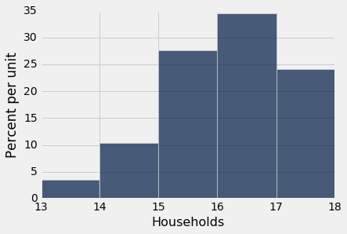
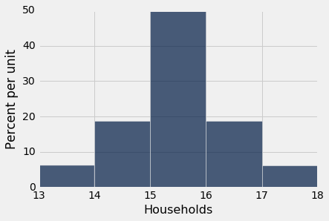
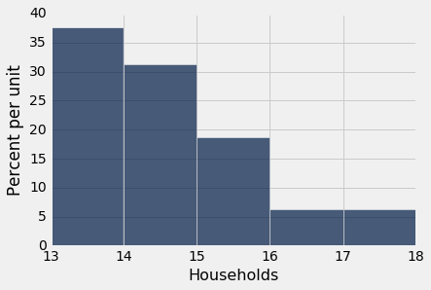
What are histograms?
Used to visualize the distribution of numerical values
.hist(“label”, bins=np.arange(low, high, step_size))
Bins on horizontal used to group into intervals: [lower bound, upper bound)
Heights refer to how crowded a bin is (density)
Left Skew (mean < median) No Skew/Balanced (mean = median) Right Skew (mean > median)
Notes:
Bins, reading histograms
Total area? Why are the units on the vertical axis the way they are
Explain includes lower bound values in bin, but not upper bound

Slide 30
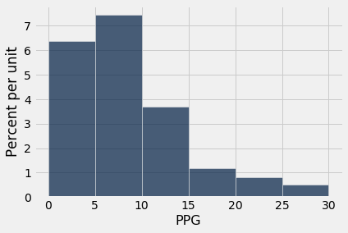
How much of my data lies in ___ range?
Bar height = (percent of data in bin) / (bin width) = percent per unit
Area of bar = (bar height) * (bar width) = % of data in bin!
Sum of all the bar areas = 100%

Slide 31
Histograms Q1
Suppose there are 50 NBA players in the table used to generate this histogram. Approximately how many of them scored <10 PPG?

Slide 32
Histograms Q1 (Solution)
Suppose there are 50 NBA players in the table used to generate this histogram. Approximately how many of them scored <10 PPG?
(50 players total) * (our desired proportion)
desired% ~ (5 * 6%) + (5 * 7.5%) = 30 + 37.5
= 67.5%
50 * (.675) = 33.75 ~ 34 players
Notes:
50 * proportion of players that scored under 10 points per game = # of players that scored less than 10 points per game
can round up to 34 humans

Slide 33
Histograms Q1.5
Suppose there are 50 NBA players in the table used to generate this histogram. Approximately how many of them scored <10 PPG?
(50 players total) * (our desired proportion)
desired% ~ (5 * 6%) + (5 * 7.5%) = 30 + 37.5
= 67.5%
50 * (.675) = 33.75 ~ 34 players
Can we find the number of players that scored <12 PPG?
Notes:
Q1.5 = No, we can’t! We have no way of knowing how many players in the [10, 15) bin scored under 12 points per game. Can I provide an interval? Lower bound and upper bound?

Slide 34
Functions

Slide 35
Functions
Structure of a Function:
def <function name>(<zero, or, more, arguments>):
<body>
<body>
return <some value> # optional
Defining the function does not actually run it, you must actually call it!

Slide 36
Interpreting Functions
To think about how a function will work, substitute arguments with their values and substitute the value the function returns for the function call. So:
def multiply_by_three(x): //Function definition
return x*3
multiply_by_three(4) //Function call
This call should evaluate to 3*4 = 12 since we substitute x with 4

Slide 37
Functions To Know
Common Utility Functions:
max, min, len, print, ...
Numpy Functions:
np.arange, np.mean/average, np.std, …
np.append(arr, value) # returns a copy of arr but with value tacked on
np.count_nonzero
np.random.choice(arr, n) # picks n items at random from arr and returns them
Notes:
np.random.choice

Slide 38
Question 1
Write a function to_standard(arr) that takes in an array and returns the array elements converted to standard units.
Remember that the conversion is x_su = (x-mean(x))/ sd(x), where x_su is x in standard units.

Slide 39
Question 1 (Solution)
Write a function to_standard(arr) that takes in an array and returns the array elements converted to standard units.
Remember that the conversion is x_su = (x-mean(x))/ sd(x), where x_su is x in standard units.
def to_standard(arr):
return (arr - np.mean(arr)) / (np.std(arr))

Slide 40
Question 2
Write a function which simulates n rolls of k-sided dice. The output should be an array of n numbers each representing a roll (number 1 through k).
np.random.choice is a good function to use; given an array and a number k as inputs, the function returns an array containing k random draws from the array.

Slide 41
Question 2 (Solution)
Write a function which simulates n rolls of k-sided dice. The output should be an array of n numbers each representing a roll (number 1 through k).
def die_rolls(n, k):
dice = np.arange(1, k+1)
return np.random.choice(dice, n)

Slide 42
Question 3
Write a function that accepts as arguments an array and an entry. It should return the number of times the entry appears in the array.

Slide 43
Question 3 (Solution)
Write a function that accepts as arguments an array and an entry. It should return the number of times the entry appears in the array.
def entry_count(arr, entry):
return np.count_nonzero(arr == entry)
(Recall that arr==entry produces an array of Trues and Falses. np.count_nonzero counts Trues as 1 and Falses as 0)

Slide 44
Iteration

Slide 45
For Loops: our favorite way to iterate
Useful for looping through a sequencing - doing something to each element in an array
Two main reasons we'd want to loop through something
Want to run some line of code multiple times, so we loop through some array of a predetermined length (i.e., arange)
We want to loop through and access/use every element in some array
for i in np.arange(6): print(‘Hello!’) | halves = make_array() for i in make_array(2,4,5,8): halves = np.append(halves, i/2)

Slide 46
For Loop Example 1
arr = make_array()
for i in make_array(1,3,5,7):
arr = np.append(arr, i + 1)
print(arr)
# (can’t use i after end of loop)

Slide 47
For Loop Example 2
coin = make_array(0, 1) flips = make_array()
for turn in np.arange(2000): flip = np.random.choice(coin) flips = np.append(flips, flip)
num_heads = np.count_nonzero(flips)

Slide 48
Practice Problem 1
# Make an array containing the first 8 Square positive numbers (not including 0)
arr = for :
Describe to your neighbor the purpose of each part of your code.

Slide 49
Practice Solution 1
# Make an array containing the first 8 perfect square numbers (not including 0)
arr = make_array() for num in np.arange(1, 9): arr = np.append(arr, num ** 2)
Or another solution could be:
arr = np.arange(1,9) ** 2

Slide 50
Practice
# Randomly pick 10000 numbers between 1 and 10, and count the number of 7’s.
num_seven = 0 numbers =
for :
…
…
print(num_seven)
Notes:
Probability question: How many sevens would I expect in 10000 rolls?

Slide 51
Practice
# Randomly pick 10000 numbers between 1 and 10, and count the number of 7’s.
num_seven = 0 numbers = np.arange(1, 11) for i in np.arange(10000): if np.random.choice(numbers) == 7: num_seven = num_seven + 1
print(num_seven)
Notes:
Probability question: How many sevens would I expect in 10000 rolls?

Slide 52
Practice
Write a function that accepts as arguments a Table and an entry. This entry can be either a string or a number (or anything that can be put into a Table). Return the number of times this entry appears in the entire table. (Hint: How do you find the number of entries that equal a specific value in an array?)
one | two | three | four
5 | 3 | 8 | 2
6 | 9 | 2 | 8
1 | 0 | 5 | 1
8 | 0 | 6 | 5
8 | 7 | 9 | 0
8 | 6 | 6 | 0

Slide 53
Practice
Write a function that accepts as arguments a Table and an entry. This entry can be either a string or a number (or anything that can be put into a Table). Return the number of times this entry appears in the entire table. (Hint: How do you find the number of entries that equal a specific value in an array?)
def num_appearances(tbl, entry):
total = 0
for i in np.arange(tbl.num_columns):
total = total + sum(tbl.column(i) == entry)
return total
one | two | three | four
5 | 3 | 8 | 2
6 | 9 | 2 | 8
1 | 0 | 5 | 1
8 | 0 | 6 | 5
8 | 7 | 9 | 0
8 | 6 | 6 | 0
Notes:
Note (12/13/19): this solution doesn’t work on a column of strings.

Slide 54
Sampling

Slide 55
Sampling
Many ways to sample -- you should know:
Random sampling (uniformly at random from a population)
Can be with replacement (if you’re drawing tickets from a bag, you put the ticket back before drawing the next one)
Or without replacement (you don’t put your ticket back in the bag before drawing the next one)
Beware of convenience sampling - convenience samples aren’t representative of the population distribution, so you can’t come to any conclusions about the population
Notes:
Example of convenience sampling: asking the first 100 students that walk into Data 8 lecture

Slide 56
Sampling
Random sampling: uniformly at random from a population
With Replacement:
Example: if you’re drawing tickets from a bag, you put the ticket back before drawing the next one
Without Replacement:
Example: if you’re drawing tickets from a bag, you don’t put your ticket back in the bag before drawing the next one
Notes:
Beware of convenience sampling - convenience samples aren’t representative of the population distribution, so you can’t come to any conclusions about the population
Example of convenience sampling: asking the first 100 students that walk into Data 8 lecture

Slide 57
Sampling from a table
tbl.sample()
By default, takes random sample with replacement of same size as original table (n=tbl.num_rows)
Perfect for bootstrapping!
How do we use sampling in A/B testing?
Otherwise:
tbl.sample(40, with_replacement=False)
Returns a new table with 40 rows randomly picked from the original table without replacement

Slide 58
Sampling from a distribution
sample_proportions(sample_size, array_of_model_proportions)
Draws sample_size objects from the distribution specified by the array_of_model_proportions
Returns the proportion of each outcome drawn after sample_size draws
Ex: sample_proportions(20, make_array(0.3, 0.7)) can return array([0.25, 0.75]), meaning in the 20 draws, the first outcome appeared 5 times and the second outcome appeared 15 times
Notes:
Expound on the example

Slide 59
Sampling Question 1
Below is a table of NBA players from Cal.
a) Suppose we stumble upon a sample of cal_nba in which Jaylen Brown appears in two rows. Was this sample constructed with or without replacement from cal_nba?
cal_nba.show(5)
PlayerName | Salary
Ryan Anderson | 20421546
Jaylen Brown | 5169960
Allen Crabbe | 18500000
Ivan Rabb | 1378242
Tyrone Wallace | 1349383
b) Write code to randomly pick 12 players from cal_nba without replacement and find their average salary.
…(24 rows omitted)

Slide 60
Sampling Question 1
Below is a table of NBA players from Cal.
a) Suppose we stumble upon a sample of cal_nba in which Jaylen Brown appears in two rows. Was this sample constructed with or without replacement from cal_nba?
With replacement! We can’t get duplicates when sampling without replacement.
cal_nba.show(5)
PlayerName | Salary
Ryan Anderson | 20421546
Jaylen Brown | 5169960
Allen Crabbe | 18500000
Ivan Rabb | 1378242
Tyrone Wallace | 1349383
b) Write code to randomly pick 12 players from cal_nba without replacement and find their average salary.
twelve = cal_nba.sample(12, with_replacement=False)
np.average(twelve.column(“Salary”))
…(24 rows omitted)

Slide 61
Sampling Question 2
Marshawn Lynch has a magic, bottomless jar of assorted Skittles. The skittles table below describes the probability distribution of flavors present in the jar. Find the number of lemon-flavored Skittles that Marshawn will collect in a simulation where he draws from the jar 30 times.
Flavor | Proportion
Grape | 0.24
Lemon | 0.12
Green Apple | 0.44
Orange | 0.11
Strawberry | 0.09
Notes:
sample_proportions

Slide 62
Sampling Question 2
Marshawn Lynch has a magic, bottomless jar of assorted Skittles. The skittles table below describes the probability distribution of flavors present in the jar. Find the number of lemon-flavored Skittles that Marshawn will collect in a simulation where he draws from the jar 30 times.
Flavor | Proportion
Grape | 0.24
Lemon | 0.12
Green Apple | 0.44
Orange | 0.11
Strawberry | 0.09
probabilities = skittles.column(“Proportion”)
drawn_props = sample_proportions(30, probabilities)
30 * drawn_props.item(1)
Notes:
sample_proportions

